Slide 1

Northwind Traders – Power BI Analysis
Business Intelligence & Analytics Dashboard
Prepared by - SAGAR S M

Slide 2
Project Overview
Project Objective: Develop a comprehensive, interactive Power BI dashboard that transforms Northwind Traders' data into actionable insights across six key business areas, enabling data-driven decision making and operational optimization. Analysis of sales, customers, suppliers, shipping, and logistics using Excel, SQL & Power BI.
Analysis Scope: Comprehensive analysis covering customer demographics and behavior, sales trends and revenue tracking, employee performance, product profitability and inventory management, supplier reliability, and shipping efficiency. The scope includes data from seven core entities: Customers, Employees, Products, Orders, Suppliers, Categories, and Shippers.
Goal: Create a visually appealing, interactive dashboard providing a holistic operational view with dynamic filtering, drill-down capabilities, and ad hoc analysis functionality. Enable stakeholders to independently explore data patterns and make informed decisions across all organizational levels to maintain competitiveness.

Slide 3
Project Overview
Insights & Recommendations: Key focus areas include optimizing inventory levels to reduce carrying costs, enhancing customer satisfaction through behavioral insights to reduce churn, analyzing sales patterns to identify seasonal trends and growth opportunities, and recognizing top performers to boost productivity and inform training initiatives.
Report & Presentation: Deliver a comprehensive Power BI report with consistent design language, interactive visualizations (charts, graphs, tables), cross-filtering capabilities, and intuitive navigation. The presentation should clearly communicate complex data patterns to business stakeholders, decision makers, and data analysts for real-world business intelligence application.
Overall Insights: The project enables customer intelligence through preference analysis, sales optimization via trend identification, operational excellence through inventory and supply chain streamlining, and workforce management through performance recognition. Success is measured by stakeholders' ability to independently explore data and drive decisions that enhance competitiveness in the wholesale market.

Slide 4
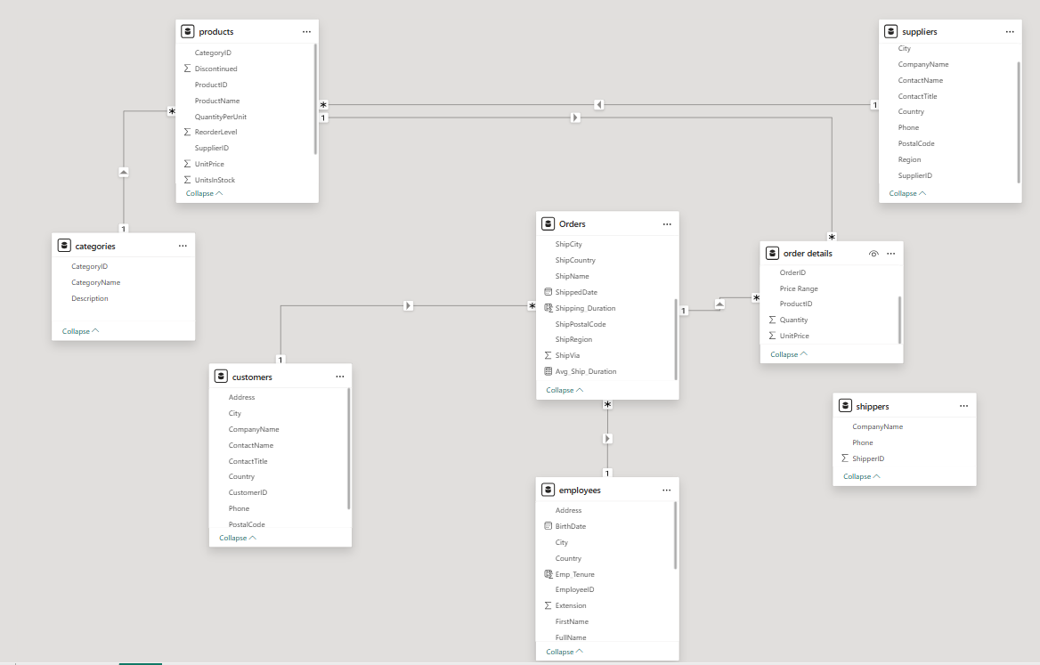
ER Diagram

Slide 5
Power BI EDA – Questions
How does customer distribution vary across different countries or cities? Use bar chart or map to visualize.
What is the trend in customer orders over time? Use line chart or area chart to visualize.
What is the distribution of customers by Contact Title or Region? Use stacked bar chart or pie chart to visualize.
How does order volume change over time? Use line chart or stacked bar chart to visualize.
What is the distribution of order values? Use histogram or box plot to visualize.
What is the average order shipping duration? Use bar chart or box plot to visualize.
What is the count of employees by job title or region? Use stacked bar chart or tree map to visualize.

Slide 6
Power BI EDA – Questions
What is the distribution of employee tenure? Use histogram or box plot to visualize.
What is the reporting structure among employees? Use org chart or hierarchical tree to visualize.
Which products have the highest sales volume? Use bar chart or tree map to visualize.
How does the sales volume vary across different product categories? Use stacked bar chart or tree map to visualize.
Can we visualize the pricing distribution of products? Use box plot or histogram to visualize.
How many products are supplied by each supplier? Use bar chart or pie chart to visualize.
How does product pricing vary across different suppliers? Use box plot or stacked column chart to visualize.
What is the geographical distribution of suppliers? Use map chart or bubble map to visualize.

Slide 7
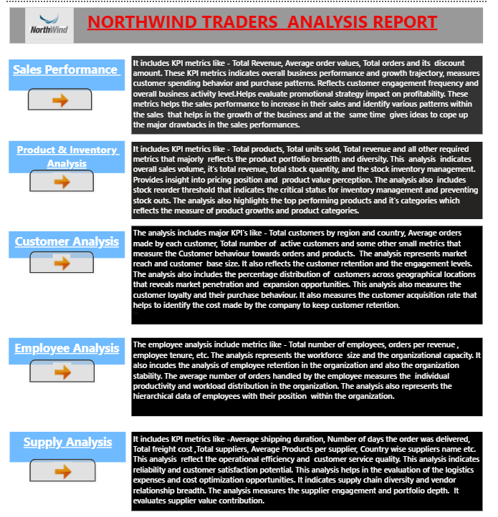
North Wind Traders Analysis Report

Slide 8
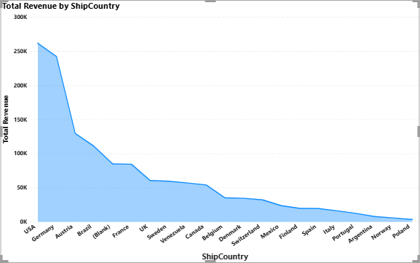
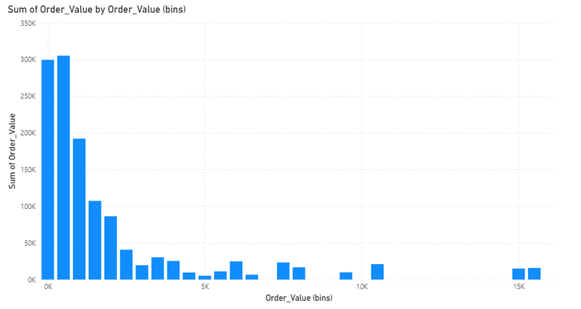
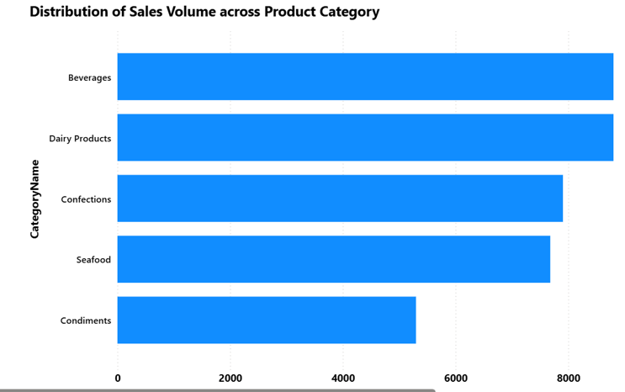
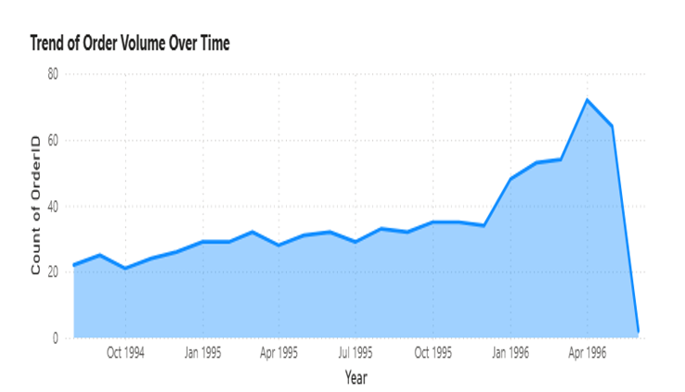
SALES Analysis

Slide 9
Sales Analysis
Key Insights:
  Clear upward trend in order volumes from 1996 to 1998 with seasonal peaks during mid-year and year-end periods
  Majority of orders fall in $0-$500 range with right-skewed distribution; average order value around $600-$800
  Most shipments complete within 5-10 days; Federal Shipping fastest, international orders show higher variance
  Notable Q1 dips suggest slower post-holiday demand with consistent month-over-month cyclical fluctuations
  Long tail of high-value orders (above $2,000) indicates presence of premium bulk customers
  Significant opportunity to optimize slower shipping routes and methods

Slide 10
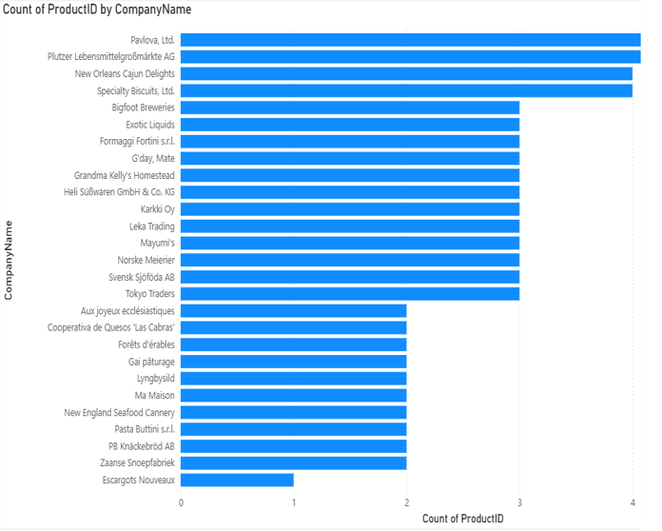
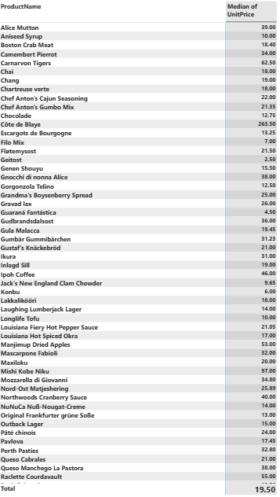
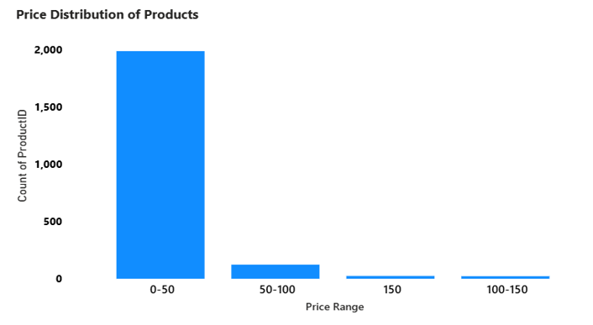
Product & Inventory Analysis

Slide 11
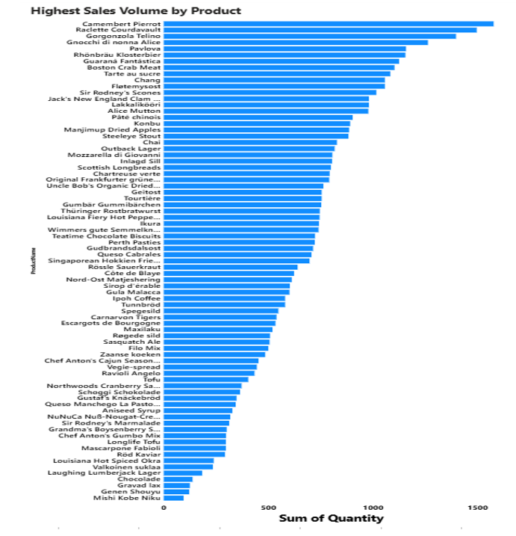

Slide 12
PRODUCT & INVENTORY ANALYSIS
Key Insights:
  Top 10 products contribute 30-35% of total sales; Côte de Blaye and Thüringer Rostbratwurst lead in revenue
  Beverages and Dairy Products are leading categories accounting for over 50% combined with top 3 categories
  Median product price ranges $15-$25 with significant outliers above $100 for premium specialty items
  Confections and Seafood show strong performance while Grains/Cereals and Produce lag significantly
  Beverages show widest pricing variance; most categories cluster in $10-$40 range
  Clear price differentiation strategy visible across portfolio with significant drop-off after top 5 products

Slide 13
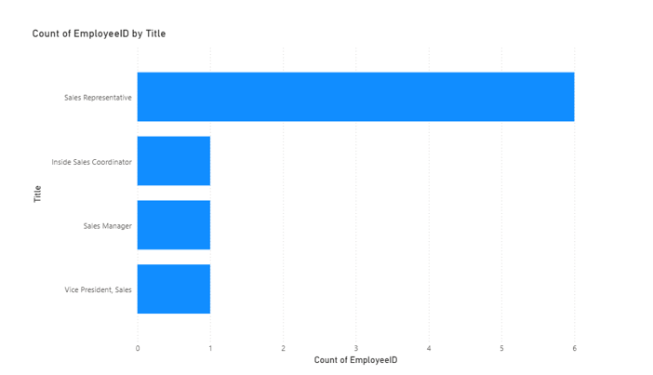
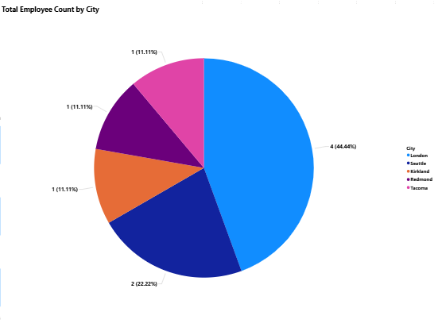
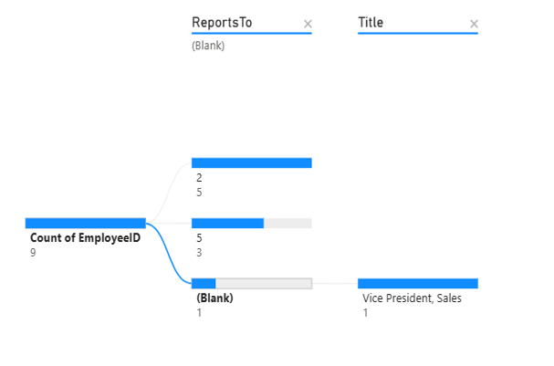
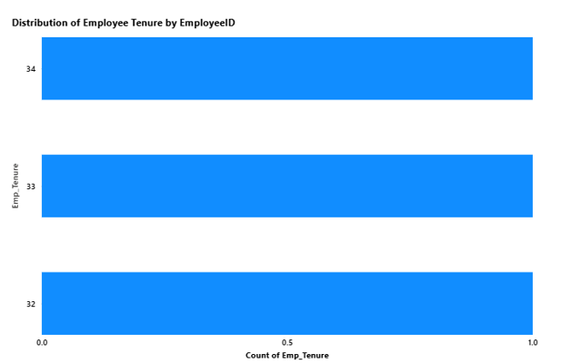
Employee Analysis

Slide 14
EMPLOYEE ANALYSIS
Key Insights:
Sales Representatives form largest employee group in sales-focused organizational structure
Most employees have 2-5 years tenure indicating low turnover and stable workforce
2-3 tier organizational hierarchy with average span of control of 4-6 direct reports
Recent hiring wave visible in 0-2 year tenure range with limited long-tenured employees (8+ years)
Relatively flat organization structure with minimal management layers ensuring efficient communication
Sales team organized through regional structure with centralized reporting to few senior managers

Slide 15
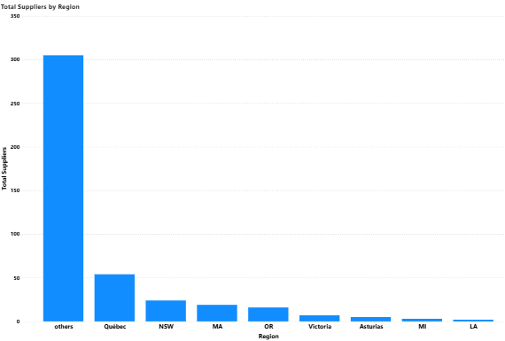
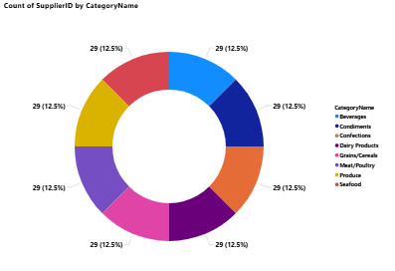
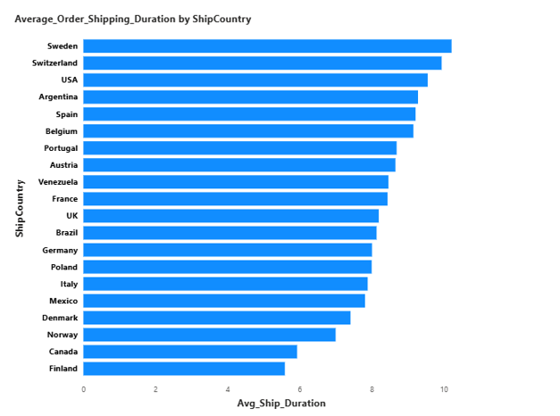
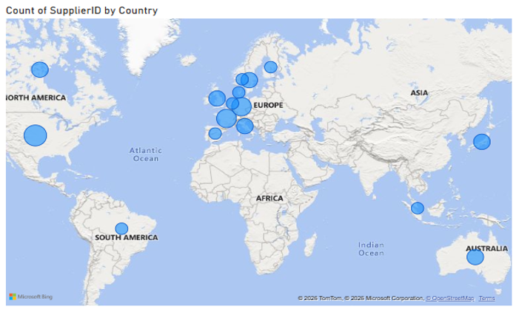
Supplier Analysis

Slide 16
SUPPLY ANALYSIS
Key Insights:
  Top 10 suppliers account for 50%+ of product portfolio; top suppliers provide 8-15 products each
  European suppliers dominate (60-70%); USA, UK, and Germany are primary supplier countries
  Seafood and Dairy show highest price variance among suppliers; Confections pricing relatively consistent
  Long tail of suppliers with only 1-2 products indicates consolidation opportunity
  Limited Asian supplier presence; Australia/New Zealand serve niche specialty items
  Geographic concentration in Europe creates supply chain vulnerability and significant negotiation opportunities exist

Slide 17
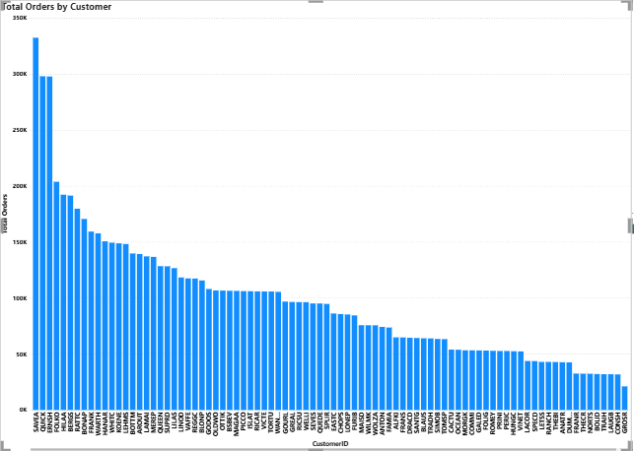
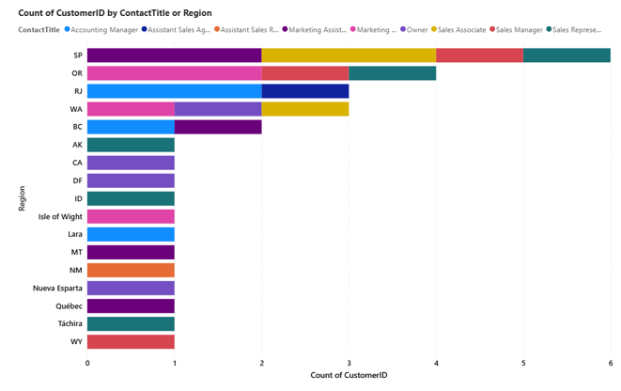
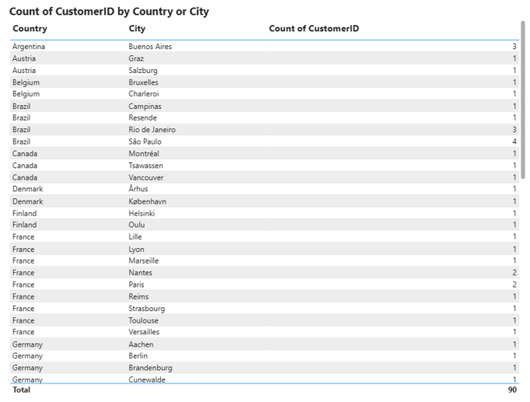
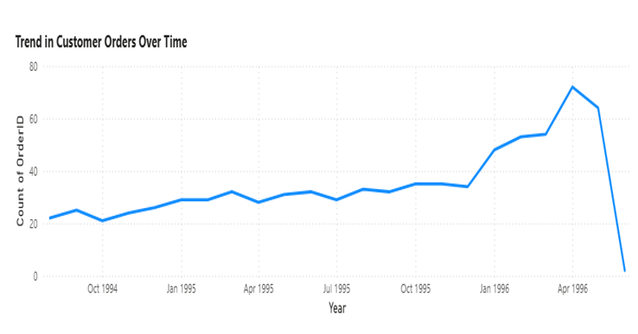
Customer Analysis

Slide 18
CUSTOMER ANALYSIS
Key Insights:
  USA, Germany, and France dominate customer base; top 5 countries account for 60%+ of total customers
  Consistent growth in customer acquisition from 1996-1998 with increasing repeat order rates over time
  Owners represent largest contact segment (30-35%) followed by Sales Representatives
  European markets show strong concentration; Latin American and Asian presence minimal
  Customer engagement peaks align with order volume peaks; retention appears strong based on recurring patterns
  Wide variety of contact titles indicates diverse B2B relationships with direct decision-maker access

Slide 19
Strategic Recommendations
Prioritize retention of high-value customers in USA/Germany markets while aggressively expanding into underrepresented Latin American and Asian regions.
Concentrate inventory investment on top-performing Beverages, Dairy, and Seafood categories while phasing out underperforming Grains/Cereals.
Diversify supplier base beyond European concentration to mitigate supply chain risks and leverage pricing variance for negotiation advantages.
Optimize shipping partnerships with Federal Shipping and Speedy Express based on performance data.
Strengthen sales team presence in emerging markets and implement dynamic pricing for high-variance product categories to maximize margins.

Slide 20
Conclusion
Data-driven insights support better business decisions
Northwind Traders exhibits strong foundational performance driven by concentrated high-value customers and top-tier products, but concentration risks across geography, suppliers, and categories demand immediate diversification strategies.
The analysis reveals substantial untapped potential in underrepresented markets and significant margin improvement opportunities through supplier negotiation and pricing optimization.
By leveraging these data-driven insights to shift from reactive to predictive decision-making, the company can achieve sustainable growth, enhanced profitability, and strengthened competitive positioning in the specialty foods wholesale industry.

Slide 21
THANK YOU

